Slide 1
构建和训练神经网络

Slide 2
目录
01
引言
02
数据预处理
03
数据读取器
04
定义Neuron类
05
定义NeuronLayer类
06
定义NeuralNetwork类
07
训练神经网络

Slide 3
引言
01

Slide 4


背景介绍
神经网络发展
构建训练意义
神经网络技术不断突破，应用领域广泛
构建和训练神经网络对人工智能发展至关重要

Slide 5


目标与意义
学习基本模型构造
构建和训练神经网络，从基础入手，提升对于机器学习的理解
有效发挥本课程所学
本课程从人工智能进展角度开展，涉及大量图像处理以及机器学习相关内容

Slide 6


方法概述
神经网络构建
神经网络训练
构建神经网络模型，包括输入层、隐藏层和输出层
通过反向传播算法训练神经网络，优化模型参数

Slide 7
数据预处理
02

Slide 8

数据预处理重要性
便于搭建模型的输入层
减少计算成本
增强模型泛化能力
预处理能规范化输入数据的类型和格式，便于确定输入层的神经元以及单个神经元输入的个数
预处理能减少数据冗余和噪声，降低模型训练的计算成本
预处理能增强模型的泛化能力，使其更好地适应新数据和新场景

Slide 9
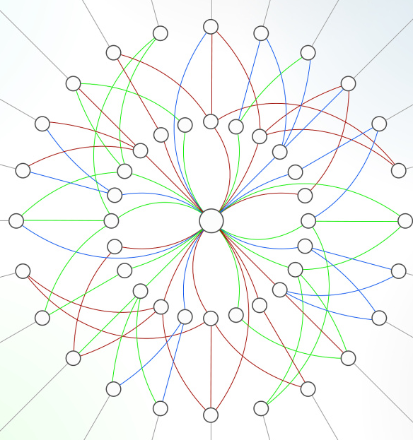

data_mapper函数作用
数据映射处理
数据预处理
实现数据格式转换
提升模型训练效果

Slide 10
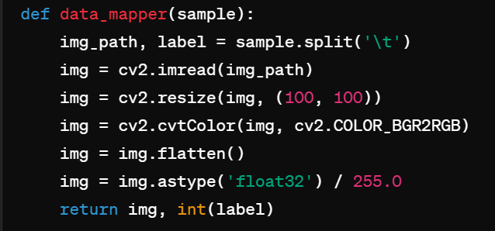
示例代码讲解

Slide 11
数据读取器
03

Slide 12



数据读取器作用
数据预处理
数据加载
数据迭代
实现数据清洗、转换和增强
高效读取数据，支持并行批量处理
提供数据迭代接口，方便模型训练

Slide 13
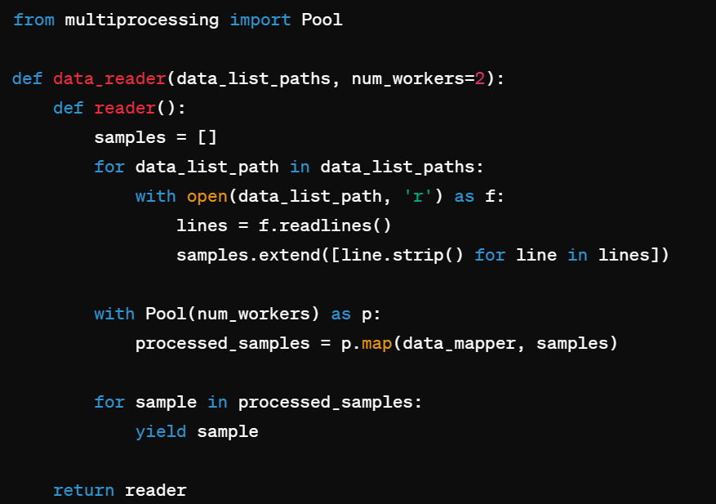
示例代码讲解

Slide 14
定义Neuron类
04

Slide 15

Neuron类作用
实现神经网络节点
作为神经网络的基本单元，是最基本单位的构建，并且在这里确定了激活函数

Slide 16
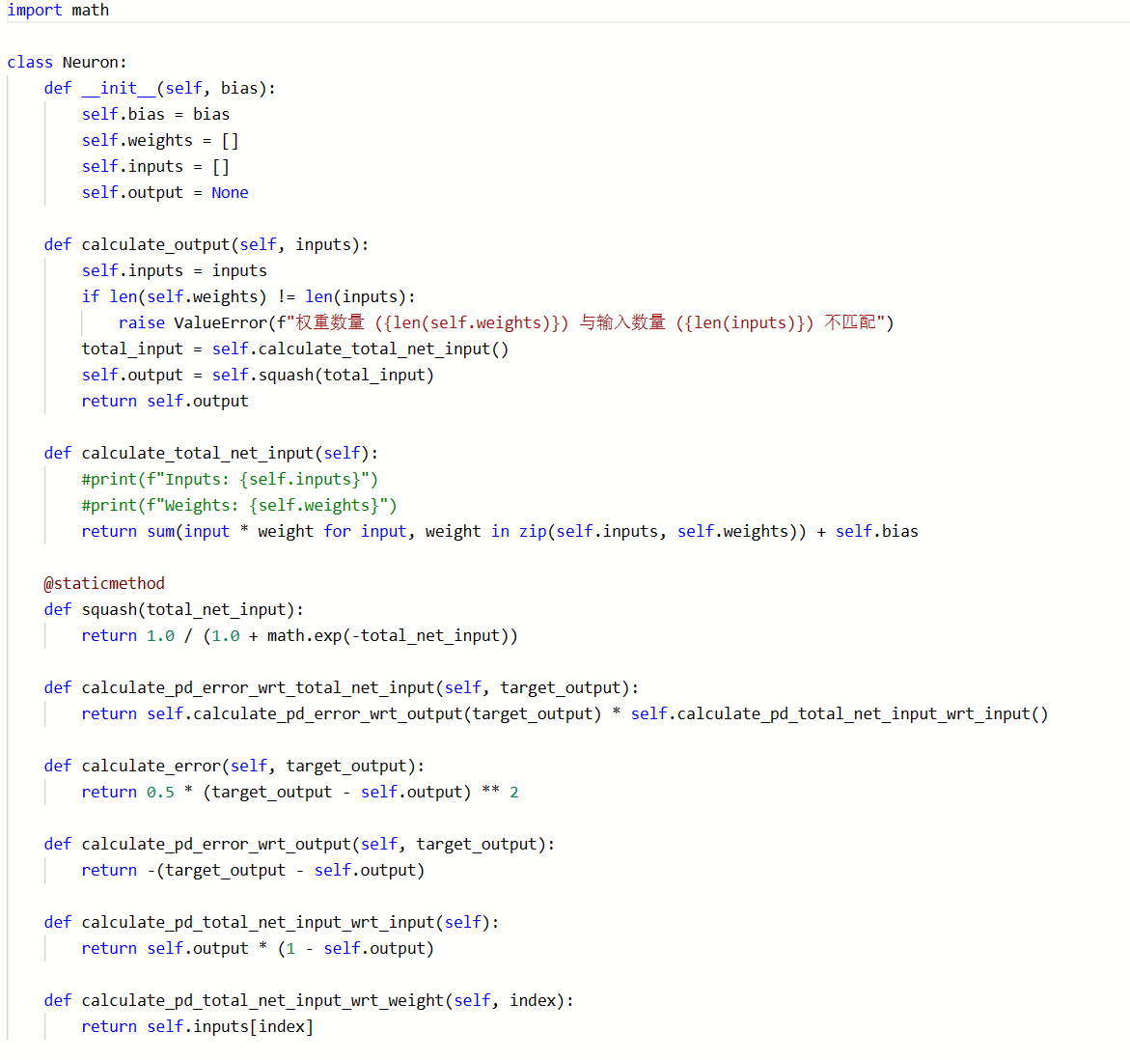
示例代码讲解
__init__ 方法
作用：初始化一个神经元。
参数：bias 表示神经元的偏置。
属性：
self.bias：神经元的偏置。
self.weights：神经元的权重列表。
self.inputs：神经元的输入列表。
self.output：神经元的输出值。
squash 静态方法
作用：使用 Sigmoid 激活函数将总网络输入转换为输出。
参数：total_net_input 表示总的网络输入。
返回值：经过 Sigmoid 激活函数后的输出。
calculate_pd_error_wrt_total_net_input 方法
作用：计算误差关于总网络输入的偏导数。
参数：target_output 表示目标输出。
返回值：误差关于总网络输入的偏导数。
calculate_error 方法
作用：计算神经元的误差，使用均方误差（MSE）。
参数：target_output 表示目标输出。
返回值：误差值。
calculate_pd_error_wrt_output 方法
作用：计算误差关于输出的偏导数。
参数：target_output 表示目标输出。
返回值：误差关于输出的偏导数。
calculate_pd_total_net_input_wrt_input 方法
作用：计算总网络输入关于输入的偏导数。
返回值：总网络输入关于输入的偏导数。
calculate_pd_total_net_input_wrt_weight 方法
作用：计算总网络输入关于某个权重的偏导数。
参数：index 表示权重的索引。
返回值：总网络输入关于指定权重的偏导数。
calculate_output 方法
作用：计算神经元的输出。
参数：inputs 表示输入到神经元的数据。
步骤：
将输入赋值给 self.inputs。
检查权重数量与输入数量是否匹配。
计算总的网络输入（总加权输入加上偏置）。
通过激活函数 squash 计算输出。
返回输出值。
calculate_total_net_input 方法
作用：计算总的网络输入，即所有输入与相应权重的乘积之和再加上偏置。
返回值：总网络输入。

Slide 17
定义NeuronLayer类
05

Slide 18
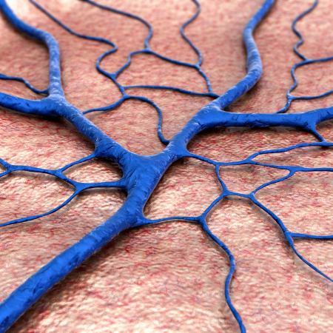

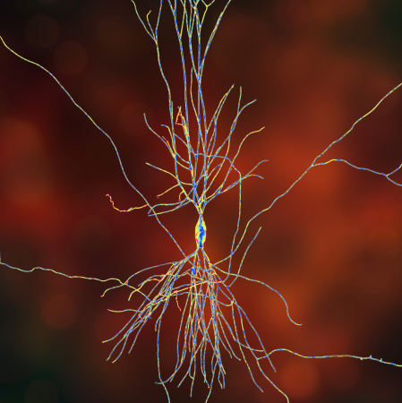
NeuronLayer类作用
构建网络结构
动态创建每层神经元
01
实现前向传播
计算输入到输出的映射关系
实现反向传播
02
根据损失函数调整网络参数
03

Slide 19
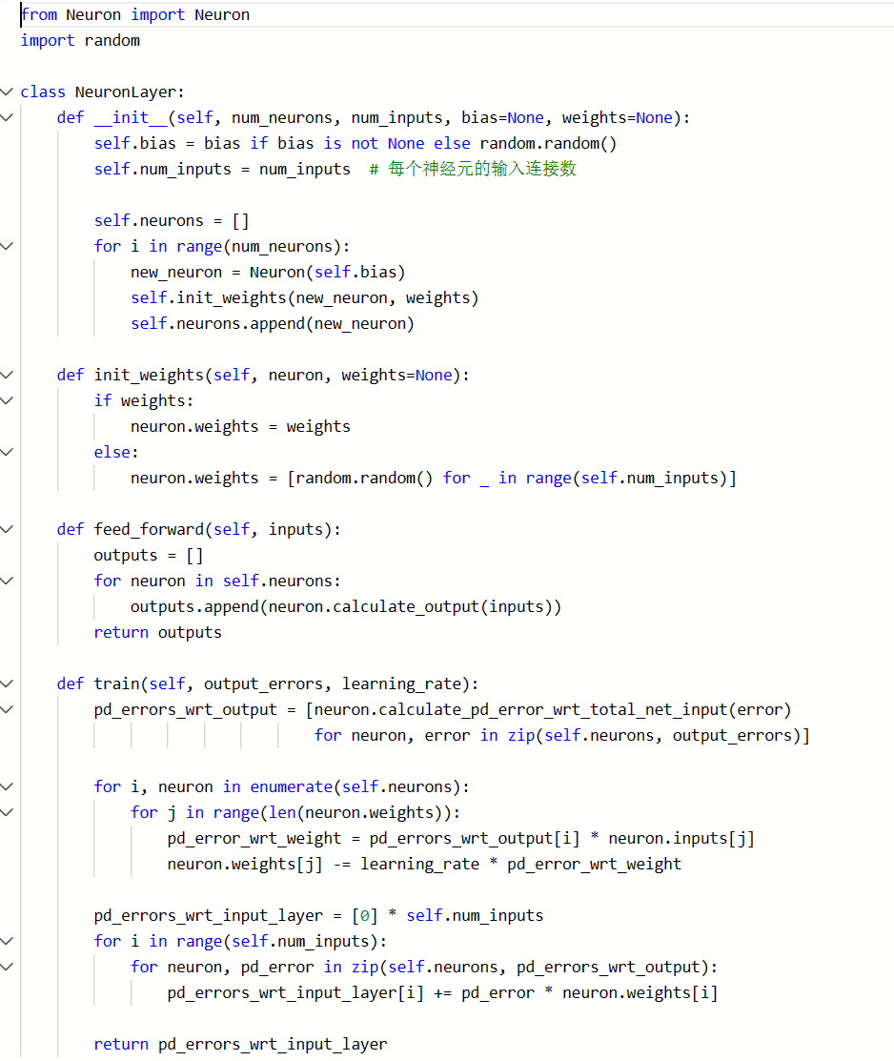
示例代码讲解

Slide 20
定义NeuralNetwork类
06

Slide 21
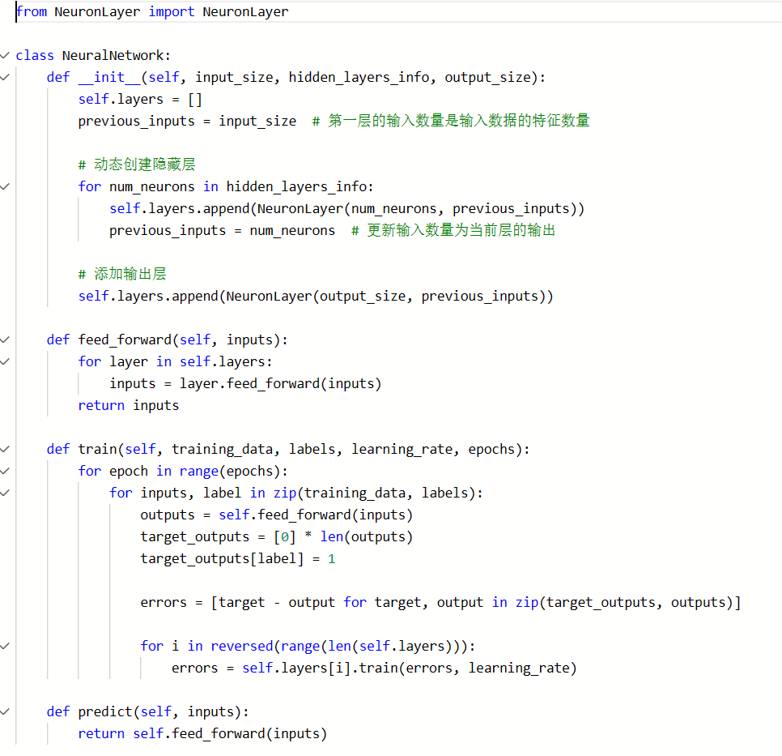
示例代码讲解

Slide 22
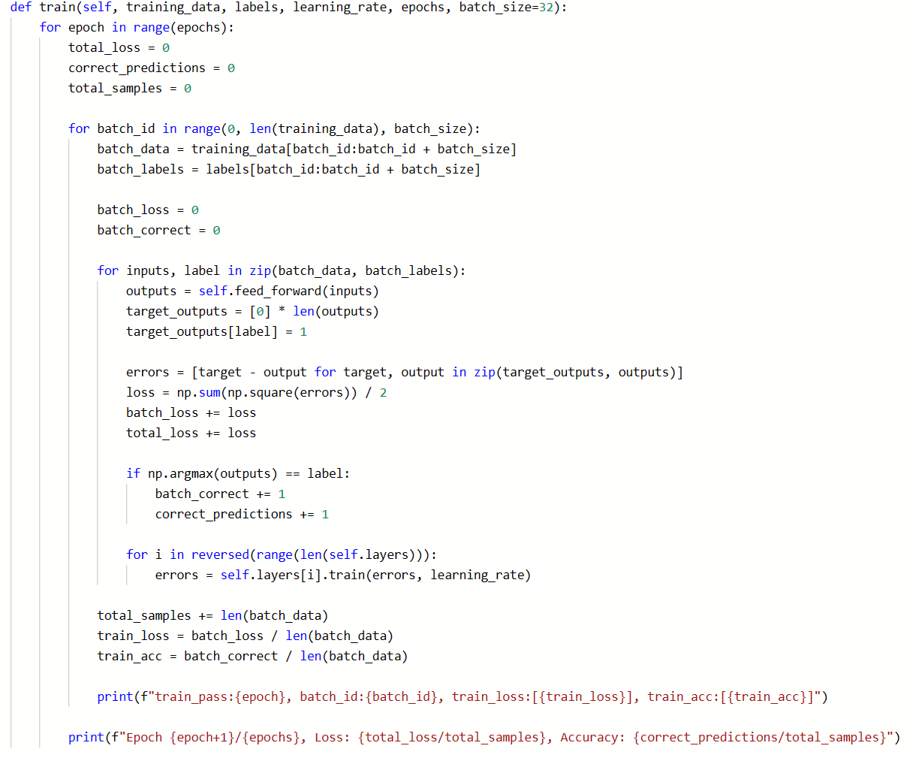
示例代码讲解

Slide 23
训练神经网络
06

Slide 24

数据读取与处理
数据读取
使用Python库读取数据集
数据预处理
清洗、转换和标准化数据

Slide 25


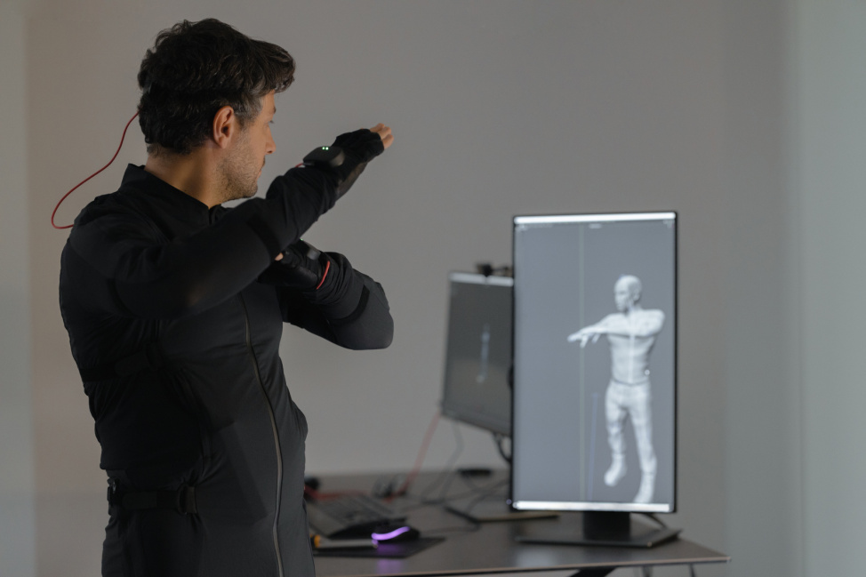
模型训练过程
数据准备
模型初始化
迭代优化
收集并处理数据，划分训练集和测试集
设置网络结构，初始化参数
通过反向传播算法，迭代优化模型参数

Slide 26
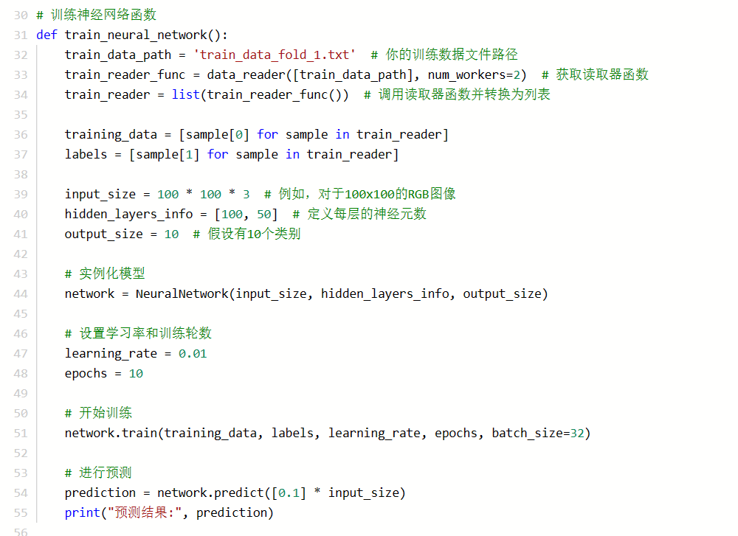
示例代码讲解

Slide 27
train_pass:0, batch_id:0, train_loss:[4.499999999681844], train_acc:[0.0]
train_pass:0, batch_id:32, train_loss:[4.499999999681844], train_acc:[0.0]
train_pass:0, batch_id:64, train_loss:[4.499999999681844], train_acc:[0.0]
train_pass:0, batch_id:96, train_loss:[4.499999999681844], train_acc:[0.0]
train_pass:0, batch_id:128, train_loss:[4.499999999681844], train_acc:[0.0]
train_pass:0, batch_id:160, train_loss:[4.499999999664412], train_acc:[0.0]
train_pass:0, batch_id:192, train_loss:[4.499999999661185], train_acc:[0.0]
train_pass:0, batch_id:224, train_loss:[4.499999999661185], train_acc:[0.0]
train_pass:0, batch_id:256, train_loss:[4.499999999661185], train_acc:[0.0]
train_pass:0, batch_id:288, train_loss:[4.499999999661185], train_acc:[0.0]
train_pass:0, batch_id:320, train_loss:[4.49999999967023], train_acc:[0.0]
train_pass:0, batch_id:352, train_loss:[4.499999999674966], train_acc:[0.0]
train_pass:0, batch_id:384, train_loss:[4.499999999674966], train_acc:[0.0]
train_pass:0, batch_id:416, train_loss:[4.499999999674966], train_acc:[0.0]
train_pass:0, batch_id:448, train_loss:[4.499999999674966], train_acc:[0.0]
train_pass:0, batch_id:480, train_loss:[4.49999999963301], train_acc:[0.0]
train_pass:0, batch_id:512, train_loss:[4.499999999591059], train_acc:[0.0]
train_pass:0, batch_id:544, train_loss:[4.499999999591059], train_acc:[0.0]
train_pass:0, batch_id:576, train_loss:[4.499999999591059], train_acc:[0.0]
train_pass:0, batch_id:608, train_loss:[4.499999999591059], train_acc:[0.0]
train_pass:0, batch_id:640, train_loss:[4.49999999964123], train_acc:[0.0]
train_pass:0, batch_id:672, train_loss:[4.4999999997248485], train_acc:[0.0]
train_pass:0, batch_id:704, train_loss:[4.4999999997248485], train_acc:[0.0]
train_pass:0, batch_id:736, train_loss:[4.4999999997248485], train_acc:[0.0]
train_pass:0, batch_id:768, train_loss:[4.4999999997248485], train_acc:[0.0]
train_pass:0, batch_id:800, train_loss:[4.499999999687385], train_acc:[0.0]
train_pass:0, batch_id:832, train_loss:[4.499999999591648], train_acc:[0.0]
train_pass:0, batch_id:864, train_loss:[4.499999999591648], train_acc:[0.0]
train_pass:0, batch_id:896, train_loss:[4.499999999591648], train_acc:[0.0]
train_pass:0, batch_id:928, train_loss:[4.499999999591648], train_acc:[0.0]
train_pass:0, batch_id:960, train_loss:[4.499999999591652], train_acc:[0.0]
train_pass:0, batch_id:992, train_loss:[4.4999999995916555], train_acc:[0.0]
train_pass:0, batch_id:1024, train_loss:[4.4999999995916555], train_acc:[0.0]
train_pass:0, batch_id:1056, train_loss:[4.4999999995916555], train_acc:[0.0]
train_pass:0, batch_id:1088, train_loss:[4.4999999995916555], train_acc:[0.0]
train_pass:0, batch_id:1120, train_loss:[4.499999999591596], train_acc:[0.0]
train_pass:0, batch_id:1152, train_loss:[4.49999999958976], train_acc:[0.0]
train_pass:0, batch_id:1184, train_loss:[4.49999999958976], train_acc:[0.0]
train_pass:0, batch_id:1216, train_loss:[4.49999999958976], train_acc:[0.0]
train_pass:0, batch_id:1248, train_loss:[4.49999999958976], train_acc:[0.0]
train_pass:0, batch_id:1280, train_loss:[4.49999999958976], train_acc:[0.0]
train_pass:0, batch_id:1312, train_loss:[4.49999999958936], train_acc:[0.90625]
train_pass:0, batch_id:1344, train_loss:[4.499999999589319], train_acc:[1.0]
train_pass:0, batch_id:1376, train_loss:[4.499999999589319], train_acc:[1.0]
train_pass:0, batch_id:1408, train_loss:[4.499999999589319], train_acc:[1.0]
train_pass:0, batch_id:1440, train_loss:[4.499999999589319], train_acc:[1.0]
train_pass:0, batch_id:1472, train_loss:[4.499999999602655], train_acc:[0.21875]
train_pass:0, batch_id:1504, train_loss:[4.499999999606389], train_acc:[0.0]
train_pass:0, batch_id:1536, train_loss:[4.499999999606389], train_acc:[0.0]
train_pass:0, batch_id:1568, train_loss:[4.499999999606389], train_acc:[0.0]
train_pass:0, batch_id:1600, train_loss:[4.499999999606389], train_acc:[0.0]
train_pass:0, batch_id:1632, train_loss:[4.499999999606389], train_acc:[0.0]
Epoch 1/10, Loss: 4.499999999630239, Accuracy: 0.09975669099756691
train_pass:1, batch_id:0, train_loss:[4.499999999681844], train_acc:[0.0]
train_pass:1, batch_id:32, train_loss:[4.499999999681844], train_acc:[0.0]
train_pass:1, batch_id:64, train_loss:[4.499999999681844], train_acc:[0.0]
train_pass:0, batch_id:0, train_loss:[4.499999999681844], train_acc:[0.0]
train_pass:0, batch_id:32, train_loss:[4.499999999681844], train_acc:[0.0]
train_pass:0, batch_id:64, train_loss:[4.499999999681844], train_acc:[0.0]
train_pass:0, batch_id:96, train_loss:[4.499999999681844], train_acc:[0.0]
train_pass:0, batch_id:128, train_loss:[4.499999999681844], train_acc:[0.0]
train_pass:0, batch_id:160, train_loss:[4.499999999664412], train_acc:[0.0]
train_pass:0, batch_id:192, train_loss:[4.499999999661185], train_acc:[0.0]
train_pass:0, batch_id:224, train_loss:[4.499999999661185], train_acc:[0.0]
train_pass:0, batch_id:256, train_loss:[4.499999999661185], train_acc:[0.0]
train_pass:0, batch_id:288, train_loss:[4.499999999661185], train_acc:[0.0]
train_pass:0, batch_id:320, train_loss:[4.49999999967023], train_acc:[0.0]
train_pass:0, batch_id:352, train_loss:[4.499999999674966], train_acc:[0.0]
train_pass:0, batch_id:384, train_loss:[4.499999999674966], train_acc:[0.0]
train_pass:0, batch_id:416, train_loss:[4.499999999674966], train_acc:[0.0]
train_pass:0, batch_id:448, train_loss:[4.499999999674966], train_acc:[0.0]
train_pass:0, batch_id:480, train_loss:[4.49999999963301], train_acc:[0.0]
train_pass:0, batch_id:512, train_loss:[4.499999999591059], train_acc:[0.0]
train_pass:0, batch_id:544, train_loss:[4.499999999591059], train_acc:[0.0]
train_pass:0, batch_id:576, train_loss:[4.499999999591059], train_acc:[0.0]
train_pass:0, batch_id:608, train_loss:[4.499999999591059], train_acc:[0.0]
train_pass:0, batch_id:640, train_loss:[4.49999999964123], train_acc:[0.0]
train_pass:0, batch_id:672, train_loss:[4.4999999997248485], train_acc:[0.0]
train_pass:0, batch_id:704, train_loss:[4.4999999997248485], train_acc:[0.0]
train_pass:0, batch_id:736, train_loss:[4.4999999997248485], train_acc:[0.0]
train_pass:0, batch_id:768, train_loss:[4.4999999997248485], train_acc:[0.0]
train_pass:0, batch_id:800, train_loss:[4.499999999687385], train_acc:[0.0]
train_pass:0, batch_id:832, train_loss:[4.499999999591648], train_acc:[0.0]
train_pass:0, batch_id:864, train_loss:[4.499999999591648], train_acc:[0.0]
train_pass:0, batch_id:896, train_loss:[4.499999999591648], train_acc:[0.0]
train_pass:0, batch_id:928, train_loss:[4.499999999591648], train_acc:[0.0]
train_pass:0, batch_id:960, train_loss:[4.499999999591652], train_acc:[0.0]
train_pass:0, batch_id:992, train_loss:[4.4999999995916555], train_acc:[0.0]
train_pass:0, batch_id:1024, train_loss:[4.4999999995916555], train_acc:[0.0]
train_pass:0, batch_id:1056, train_loss:[4.4999999995916555], train_acc:[0.0]
train_pass:0, batch_id:1088, train_loss:[4.4999999995916555], train_acc:[0.0]
train_pass:0, batch_id:1120, train_loss:[4.499999999591596], train_acc:[0.0]
train_pass:0, batch_id:1152, train_loss:[4.49999999958976], train_acc:[0.0]
train_pass:0, batch_id:1184, train_loss:[4.49999999958976], train_acc:[0.0]
train_pass:0, batch_id:1216, train_loss:[4.49999999958976], train_acc:[0.0]
train_pass:0, batch_id:1248, train_loss:[4.49999999958976], train_acc:[0.0]
train_pass:0, batch_id:1280, train_loss:[4.49999999958976], train_acc:[0.0]
train_pass:0, batch_id:1312, train_loss:[4.49999999958936], train_acc:[0.90625]
train_pass:0, batch_id:1344, train_loss:[4.499999999589319], train_acc:[1.0]
train_pass:0, batch_id:1376, train_loss:[4.499999999589319], train_acc:[1.0]
train_pass:0, batch_id:1408, train_loss:[4.499999999589319], train_acc:[1.0]
train_pass:0, batch_id:1440, train_loss:[4.499999999589319], train_acc:[1.0]
train_pass:0, batch_id:1472, train_loss:[4.499999999602655], train_acc:[0.21875]
train_pass:0, batch_id:1504, train_loss:[4.499999999606389], train_acc:[0.0]
train_pass:0, batch_id:1536, train_loss:[4.499999999606389], train_acc:[0.0]
train_pass:0, batch_id:1568, train_loss:[4.499999999606389], train_acc:[0.0]
train_pass:0, batch_id:1600, train_loss:[4.499999999606389], train_acc:[0.0]
train_pass:0, batch_id:1632, train_loss:[4.499999999606389], train_acc:[0.0]
Epoch 1/10, Loss: 4.499999999630239, Accuracy: 0.09975669099756691
train_pass:1, batch_id:0, train_loss:[4.499999999681844], train_acc:[0.0]
train_pass:1, batch_id:32, train_loss:[4.499999999681844], train_acc:[0.0]
train_pass:1, batch_id:64, train_loss:[4.499999999681844], train_acc:[0.0]
train_pass:0, batch_id:0, train_loss:[4.499999999681844], train_acc:[0.0]
train_pass:0, batch_id:32, train_loss:[4.499999999681844], train_acc:[0.0]
train_pass:0, batch_id:64, train_loss:[4.499999999681844], train_acc:[0.0]
train_pass:0, batch_id:96, train_loss:[4.499999999681844], train_acc:[0.0]
train_pass:0, batch_id:128, train_loss:[4.499999999681844], train_acc:[0.0]
train_pass:0, batch_id:160, train_loss:[4.499999999664412], train_acc:[0.0]
train_pass:0, batch_id:192, train_loss:[4.499999999661185], train_acc:[0.0]
train_pass:0, batch_id:224, train_loss:[4.499999999661185], train_acc:[0.0]
train_pass:0, batch_id:256, train_loss:[4.499999999661185], train_acc:[0.0]
train_pass:0, batch_id:288, train_loss:[4.499999999661185], train_acc:[0.0]
train_pass:0, batch_id:320, train_loss:[4.49999999967023], train_acc:[0.0]
train_pass:0, batch_id:352, train_loss:[4.499999999674966], train_acc:[0.0]
train_pass:0, batch_id:384, train_loss:[4.499999999674966], train_acc:[0.0]
train_pass:0, batch_id:416, train_loss:[4.499999999674966], train_acc:[0.0]
train_pass:0, batch_id:448, train_loss:[4.499999999674966], train_acc:[0.0]
train_pass:0, batch_id:480, train_loss:[4.49999999963301], train_acc:[0.0]
train_pass:0, batch_id:512, train_loss:[4.499999999591059], train_acc:[0.0]
train_pass:0, batch_id:544, train_loss:[4.499999999591059], train_acc:[0.0]
train_pass:0, batch_id:576, train_loss:[4.499999999591059], train_acc:[0.0]
train_pass:0, batch_id:608, train_loss:[4.499999999591059], train_acc:[0.0]
train_pass:0, batch_id:640, train_loss:[4.49999999964123], train_acc:[0.0]
train_pass:0, batch_id:672, train_loss:[4.4999999997248485], train_acc:[0.0]
train_pass:0, batch_id:704, train_loss:[4.4999999997248485], train_acc:[0.0]
train_pass:0, batch_id:736, train_loss:[4.4999999997248485], train_acc:[0.0]
train_pass:0, batch_id:768, train_loss:[4.4999999997248485], train_acc:[0.0]
train_pass:0, batch_id:800, train_loss:[4.499999999687385], train_acc:[0.0]
train_pass:0, batch_id:832, train_loss:[4.499999999591648], train_acc:[0.0]
train_pass:0, batch_id:864, train_loss:[4.499999999591648], train_acc:[0.0]
train_pass:0, batch_id:896, train_loss:[4.499999999591648], train_acc:[0.0]
train_pass:0, batch_id:928, train_loss:[4.499999999591648], train_acc:[0.0]
train_pass:0, batch_id:960, train_loss:[4.499999999591652], train_acc:[0.0]
train_pass:0, batch_id:992, train_loss:[4.4999999995916555], train_acc:[0.0]
train_pass:0, batch_id:1024, train_loss:[4.4999999995916555], train_acc:[0.0]
train_pass:0, batch_id:1056, train_loss:[4.4999999995916555], train_acc:[0.0]
train_pass:0, batch_id:1088, train_loss:[4.4999999995916555], train_acc:[0.0]
train_pass:0, batch_id:1120, train_loss:[4.499999999591596], train_acc:[0.0]
train_pass:0, batch_id:1152, train_loss:[4.49999999958976], train_acc:[0.0]
train_pass:0, batch_id:1184, train_loss:[4.49999999958976], train_acc:[0.0]
train_pass:0, batch_id:1216, train_loss:[4.49999999958976], train_acc:[0.0]
train_pass:0, batch_id:1248, train_loss:[4.49999999958976], train_acc:[0.0]
train_pass:0, batch_id:1280, train_loss:[4.49999999958976], train_acc:[0.0]
train_pass:0, batch_id:1312, train_loss:[4.49999999958936], train_acc:[0.90625]
train_pass:0, batch_id:1344, train_loss:[4.499999999589319], train_acc:[1.0]
train_pass:0, batch_id:1376, train_loss:[4.499999999589319], train_acc:[1.0]
train_pass:0, batch_id:1408, train_loss:[4.499999999589319], train_acc:[1.0]
train_pass:0, batch_id:1440, train_loss:[4.499999999589319], train_acc:[1.0]
train_pass:0, batch_id:1472, train_loss:[4.499999999602655], train_acc:[0.21875]
train_pass:0, batch_id:1504, train_loss:[4.499999999606389], train_acc:[0.0]
train_pass:0, batch_id:1536, train_loss:[4.499999999606389], train_acc:[0.0]
train_pass:0, batch_id:1568, train_loss:[4.499999999606389], train_acc:[0.0]
train_pass:0, batch_id:1600, train_loss:[4.499999999606389], train_acc:[0.0]
train_pass:0, batch_id:1632, train_loss:[4.499999999606389], train_acc:[0.0]
Epoch 1/10, Loss: 4.499999999630239, Accuracy: 0.09975669099756691
train_pass:1, batch_id:0, train_loss:[4.499999999681844], train_acc:[0.0]
train_pass:1, batch_id:32, train_loss:[4.499999999681844], train_acc:[0.0]
train_pass:1, batch_id:64, train_loss:[4.499999999681844], train_acc:[0.0]

Slide 28
谢谢

